Slide 1
PROJECT MANAGEMENT GUIDELINES
OpenDreamKit Kick-off meeting Orsay, 2/09/2015
Eugénia Shadlova, European Affairs Officer, UPSud

Slide 2
Référence documents :
Grant Agreement
Consortium Agreement
OpenDreamKit Kick-off meeting, Orsay, 2/09/2015

Slide 3
Project reporting
The coordinator must submit to the Commission , on behalf of the Consortium, the technical and financial reports.
These reports must be drawn up using the forms and templates provided in the electronic exchange system.
The coordinator must submit a periodic report within 60 days following the end of each reporting period.
OpenDreamKit Kick-off meeting, Orsay, 2/09/2015

Slide 4
Project reporting
The project is divided into the following ‘reporting periods’:
- RP1: from month 1 to month 18
- RP2: from month 19 to month 36
- RP3: from month 37 to month 48
OpenDreamKit Kick-off meeting, Orsay, 2/09/2015

Slide 5
The periodic report must include the following:
A ‘periodic technical report’ containing:
(i) an explanation of the work carried out by the beneficiaries;
(ii) an overview of the progress towards the objectives of the action, including milestones and deliverables identified in Annex 1.
This report must include explanations justifying the differences between work expected to be carried out in accordance with Annex 1 and that actually carried out.
The report must also detail the exploitation and dissemination of the results and an updated ‘plan for the exploitation and dissemination of the results’;
(iii) a summary for publication by the Commission;
(iv) the answers to the ‘questionnaire’, covering issues related to the action implementation and the economic and societal impact, notably in the context of the Horizon 2020 key performance indicators and the Horizon 2020 monitoring requirements;
OpenDreamKit Kick-off meeting, Orsay, 2/09/2015

Slide 6
The periodic report must include the following:
2. a ‘periodic financial report’ containing:
(i) an ‘individual financial statement’ from each beneficiary and from each linked third party, for the reporting period concerned.
The individual financial statement must detail the eligible costs for each budget category. The beneficiaries and linked third parties must declare all eligible costs, even if . If an individual financial statement is not submitted for a reporting period, it may be included in the periodic financial report for the next reporting period.
(ii) an explanation of the use of resources and the information on subcontracting and in-kind contributions provided by third parties from each beneficiary and from each linked third party, for the reporting period concerned;
(iv) a ‘periodic summary financial statement’, created automatically by the electronic exchange system, consolidating the individual financial statements for the reporting period concerned and including — except for the last reporting period — the request for interim payment.
OpenDreamKit Kick-off meeting, Orsay, 2/09/2015

Slide 7
The final report must include the following:
a ‘final technical report’ with a summary for publication containing:
(i) an overview of the results and their exploitation and dissemination;
the conclusions on the action, and
(iii) the socio-economic impact of the action;
a ‘final financial report’ containing:
(i) a ‘final summary financial statement’ (see Annex 4), created automatically by the electronic exchange system, consolidating the individual financial statements for all reporting periods and including the request for payment of the balance and
(ii) a ‘certificate on the financial statements’ (drawn up in accordance with Annex 5) for each beneficiary and for each linked third party, if it requests a total contribution of EUR 325 000 or more, as reimbursement of actual costs and unit costs calculated on the basis of its usual cost accounting practices (see Article 5.2 and Article 6.2, Point A).
OpenDreamKit Kick-off meeting, Orsay, 2/09/2015

Slide 8
Obligation to submit deliverables
The coordinator must submit, on behalf of the Consortium, via the electronic exchange system, the ‘deliverables’ identified in Annex 1, in accordance with the timing and conditions set out in it.
OpenDreamKit Kick-off meeting, Orsay, 2/09/2015

Slide 9
Payements and payement arrangements
The following payments will be made to the coordinator:
pre-financing payment;
interim payments
payment of the balance
OpenDreamKit Kick-off meeting, Orsay, 2/09/2015

Slide 10
Payements and payement arrangements
The aim of the pre-financing is to provide the beneficiaries with a float. It remains the property of the EU until the payment of the balance.
Interim payments reimburse the eligible costs incurred for the implementation of the action during the corresponding reporting periods.
The Commission will pay to the coordinator the amount due as interim payment within 90 days from receiving the periodic report.
Payment is subject to the approval of the periodic report. Its approval does not imply recognition of the compliance, authenticity, completeness or correctness of its content.
Payments will be made to the coordinator. The coordinator must distribute the payments between the beneficiaries without unjustified delay.
OpenDreamKit Kick-off meeting, Orsay, 2/09/2015

Slide 11
Budget transfers
The estimated budget breakdown indicated in Annex 2 may be adjusted by transfers of amounts between beneficiaries or between budget categories (or both). This does not require an amendment according to Article 55, if the action is implemented as described in Annex 1.
However, the beneficiaries may not add costs relating to subcontracts not provided for in Annex 1, unless such additional subcontracts are approved by an amendment.
OpenDreamKit Kick-off meeting, Orsay, 2/09/2015

Slide 12
Keeping records
The beneficiaries must — for a period of five years after the payment of the balance — keep records and other supporting documentation in order to prove the proper implementation of the action and the costs they declare as eligible
They must make them available upon request or in the context of checks, reviews, audits or investigations.
The beneficiaries must keep the original documents. Digital and digitalised documents are considered originals if they are authorised by the applicable national law.
OpenDreamKit Kick-off meeting, Orsay, 2/09/2015

Slide 13
Dissemination of results
During the Project and for a period of 1 year after the end of the Project, each beneficiary must ‘disseminate’ its results by disclosing them to the public by appropriate means, including in scientific publications.
A beneficiary that intends to disseminate its results must give advance notice to the other beneficiaries of at least 45 days, together with sufficient information on the results it will disseminate.
Any other beneficiary may object within 30 days of receiving notification, if it can show that its legitimate interests in relation to the results or background would be significantly harmed. If no objection is made within this time limit, the publication is permitted.
OpenDreamKit Kick-off meeting, Orsay, 2/09/2015

Slide 14
Dissemination of results
Any dissemination of results (in any form, including electronic) must:
(a) display the EU emblem and
(b) include the following text:
“This project has received funding from the European Union’s Horizon 2020 research and innovation programme under grant agreement No 676541”.
When displayed together with another logo, the EU emblem must have appropriate prominence.
For the purposes of their obligations under this Article, the beneficiaries may use the EU emblem without first obtaining approval from the Commission.
OpenDreamKit Kick-off meeting, Orsay, 2/09/2015

Slide 15
Open Access to scientific publications
Each beneficiary must ensure open access (free of charge online access for any user) to all peer reviewed scientific publications relating to its results.
In particular it must :
(a) as soon as possible and at the latest on publication, deposit a machine-readable electronic copy of the published version or final peer-reviewed manuscript accepted for publication in a repository for scientific publications;
Moreover, the beneficiary must aim to deposit at the same time the research data needed to validate the results presented in the deposited scientific publications.
(b) ensure open access to the deposited publication
(c) ensure open access to the bibliographic metadata that identify the deposited publication.
OpenDreamKit Kick-off meeting, Orsay, 2/09/2015

Slide 16
Open Access to research data
Regarding the digital research data generated in the Project, the beneficiaries must:
(a) deposit in a research data repository and take measures to make it possible for third parties to access, mine, exploit, reproduce and disseminate — free of charge for any user — the following:
(i) the data, including associated metadata, needed to validate the results presented in scientific publications as soon as possible;
(ii) other data, including associated metadata, as specified and within the deadlines laid down in the 'data management plan' ;
(b) provide information — via the repository — about tools and instruments at the disposal of the beneficiaries and necessary for validating the results (and — where possible — provide the tools and instruments themselves).
OpenDreamKit Kick-off meeting, Orsay, 2/09/2015

Slide 17
Recruitment, working conditions for researchers and gender equality
The beneficiaries must take all measures to implement the principles set out in the Commission Recommendation on the European Charter for Researchers and the Code of Conduct for the Recruitment of Researchers, in particular regarding:
working conditions;
transparent recruitment processes based on merit, and
career development.
The beneficiaries must ensure that researchers and third parties involved in the action are aware of them.
The beneficiaries must take all measures to promote equal opportunities between men and women in the implementation of the action.
OpenDreamKit Kick-off meeting, Orsay, 2/09/2015

Slide 18
Governance structure
The organizational structure of the Consortium includes the following Consortium Bodies:
Steering Committee (SC) as the ultimate decision-making body of the consortium;
Coordination Team (CT) as the supervisory body for the execution of the Project which shall report to and be accountable to the SC;
Advisory Board (AB) to give an independent opinion on scientific and innovation matters, in order to guaranty quality implementation of the project;
Quality Review Board (QRB) to monitor the quality of the Deliverables, their whole ‘production process’ and to recommend improvements during the project to the SC;
End User Group (EUG) to control the project execution from the point of view of the end user needs and requirements
OpenDreamKit Kick-off meeting, Orsay, 2/09/2015

Slide 19
Steering Committee (SC)
The Steering Committee shall consist of one representative of each Party
Each Steering Committee Member shall be deemed to be duly authorised to deliberate, negotiate and decide on all matters listed in Section 6.3.1.2. of the Consortium Agreement
The Coordinator shall chair all meetings of the Steering Committee, unless decided otherwise in a meeting of the Steering Committee.
The Steering Committee Members should be appointed at the kick-off meeting
OpenDreamKit Kick-off meeting, Orsay, 2/09/2015

Slide 20
Steering Committee (SC)
The following decisions shall be taken by the Steering Committee :
Content, finances and intellectual property rights
Proposals for changes to Annexes 1 and 2 of the Grant Agreement to be agreed by the Funding Authority
Changes to the Consortium Plan
Modifications to Attachment 1 (Background Included) according to 9.1.2. below
Additions to Attachment 3 (List of Third Parties for simplified transfer according to Section 8.2.2)
Proposed budget transfers
OpenDreamKit Kick-off meeting, Orsay, 2/09/2015

Slide 21
Steering Committee (SC)
2. Evolution of the consortium
Entry of a new Party to the consortium and approval of the settlement on the conditions of the accession of such a new Party
Withdrawal of a Party from the consortium and the approval of the settlement on the conditions of the withdrawal
Identification of a breach by a Party of its obligations under this Consortium Agreement or the Grant Agreement
Declaration of a Party to be a Defaulting Party
Remedies to be performed by a Defaulting Party
Termination of a Defaulting Party’s participation in the consortium and measures relating thereto
Proposal to the Funding Authority for a change of the Coordinator
Proposal to the Funding Authority for suspension of all or part of the Project
Proposal to the Funding Authority for termination of the Project and the Consortium Agreement
OpenDreamKit Kick-off meeting, Orsay, 2/09/2015

Slide 22
Coordination Team (CT)
The Coordination Team consists of the Project Coordinator, the Project Manager and Work-Package Leaders . The Coordinator shall chair all meetings of the Coordination Team, unless decided otherwise by a majority of two-thirds.
Minutes of CT meetings, once accepted, shall be sent by the Coordinator to the Steering Committee Members for information
The CT is responsible for the proper execution and implementation of the decisions of the Steering Committee.
The CT shall monitor the effective and efficient implementation of the Project.
The CT shall collect information at least every 6 months on the progress of the Project, examine that information to assess the compliance of the Project with the Consortium Plan and, if necessary, propose modifications of the Consortium Plan to the Steering Committee.
The CT shall support the Coordinator in preparing meetings with the Funding Authority and in preparing related data and deliverables
The CT shall prepare the content and timing of press releases and joint publications by the Consortium
OpenDreamKit Kick-off meeting, Orsay, 2/09/2015

Slide 23
Advisory Board (AB)
An Advisory Board (AB), composed of top level experts from partner and external organisations, will be appointed and steered by the
Steering Commitee.
The AB will give an independent opinion on scientific and innovation matters, in order to guaranty quality implementation of the project, efficient innovation management and project sustainability.
The Coordinator shall write the minutes of the AB meetings and prepare the implementation of the AB's suggestions.
The AB members shall be allowed to participate in Steering Committee meetings upon invitation but have not any voting rights.
A non-disclosure agreement will be signed with each external organization member of the AB.
OpenDreamKit Kick-off meeting, Orsay, 2/09/2015

Slide 24
Quality Review Board (QRB)
The QRB will be composed of 2 senior researchers from the Consortium, 2 representatives of the End User Group and 2 experts from the Advisory Board. It will be chaired by one of the professors within the Consortium.
All members shall be appointed at the kick-off meeting of the project.
Responsibilities: to monitor the quality of the Deliverables, their whole ‘production process’ and to recommend improvements during the project to the SC.
OpenDreamKit Kick-off meeting, Orsay, 2/09/2015

Slide 25
End-User Group (EUG)
Members: end-users of the VRE, internal and external to the consortium, from different disciplines and both from academic and industrial sector. They are actively involved into the project execution, and work in close interaction with the project coordinator.
Responsibilities: the EUG is the main actor of the innovation management within the consortium, as they have a deep understanding of both market and technical problems, and awareness of opportunities. The EUG also plays a main role in ensuring the VRE sustainability.
Tasks: to control the project execution from the point of view of the end user needs and requirements, to test the tool and to detect its potential shortcomings at the early stages, to propose adaptation measures.
OpenDreamKit Kick-off meeting, Orsay, 2/09/2015

Slide 26
Meetings
Any Party which is a member of a Consortium Body :
should be represented at any meeting of such Consortium Body;
may appoint a substitute or a proxy to attend and vote at any meeting;
and shall participate in a cooperative manner in the meetings;
The chairperson of a Consortium Body shall produce written minutes of each meeting which shall be the formal record of all decisions taken. He shall send the draft minutes to all Members within 10 calendar days of the meeting.
OpenDreamKit Kick-off meeting, Orsay, 2/09/2015

Slide 27
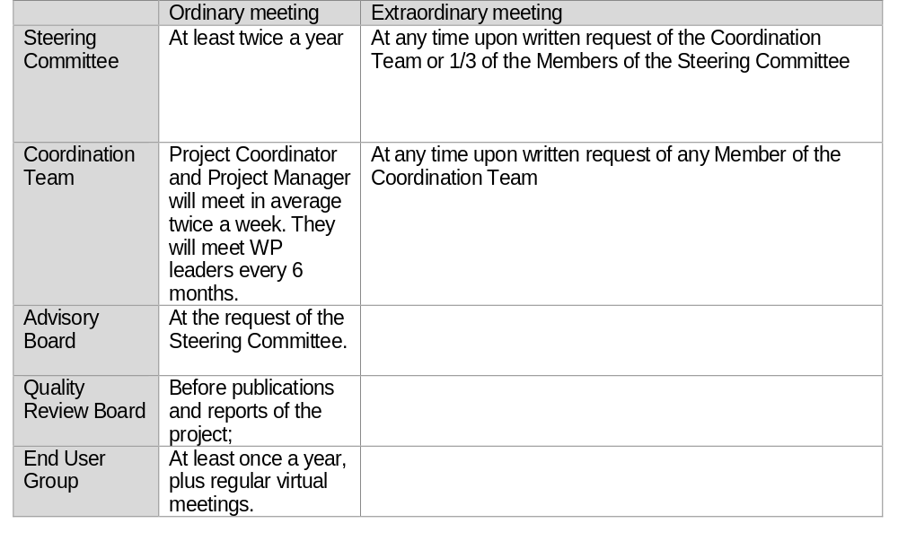
Meetings
The Chairperson of a Consortium Body should convene meetings of that Consortium Body
Meetings of each Consortium Body may also be held by teleconference or other telecommunication means.
OpenDreamKit Kick-off meeting, Orsay, 2/09/2015

Slide 28
Voting rules
Each Consortium Body shall not deliberate and decide validly unless 2/3 of its Members are present or represented, including by vitual means, such as teleconference
If this minimum is not reached, the chairperson of the Consortium Body shall convene another ordinary meeting within 15 calendar days.
Each Member of a Consortium Body present or represented in the meeting shall have one vote.
OpenDreamKit Kick-off meeting, Orsay, 2/09/2015

Slide 29
Any questions?
Eugenia.shadlova@u-psud.fr
And, since September 15 :
Benoit.pilorget@u-psud.fr
– European Project Manager for OpenDreamKit
OpenDreamKit Kick-off meeting, Orsay, 2/09/2015

